Slide 1

“Worldwide Energy Consumption Analysis”
Batch No: 450
M. Rithvik
Mamidi Rakesh

Slide 2
Agenda
Business Problem
Problem Statement
Objectives
Entity Relationship Structure
General & Comparative Analysis
Trend Analysis Over Time
Ratio & Per Capita Analysis
Global Comparisons
Recommendations
Conclusion

Slide 3
Business Problem
Countries are experiencing increase in energy demand, economic growth, and rising carbon emissions, creating challenges in maintaining environmental sustainability.
There is a need to analyze how energy production, consumption, GDP, and population are interconnected to support better policy and strategic decisions.
Problem Statement
This project analyzes global energy consumption, production, emissions, GDP, and population data using SQL.
It tries to identify trends, compare countries, and calculate key ratios such as emission-to-GDP and per capita metrics.
Understanding the relationship between economic growth and environmental impact for sustainable development insights.

Slide 4
Objective
To analyze total energy consumption and production patterns across different countries.
To evaluate carbon emissions trends and identify major emitting countries.
To study the relationship between GDP growth and energy usage over time.
To calculate and compare emission-to-GDP and per capita metrics for better efficiency analysis.
To examine how population growth impacts total energy consumption and emissions.
To derive meaningful insights that support sustainable development and energy policy decisions.

Slide 5
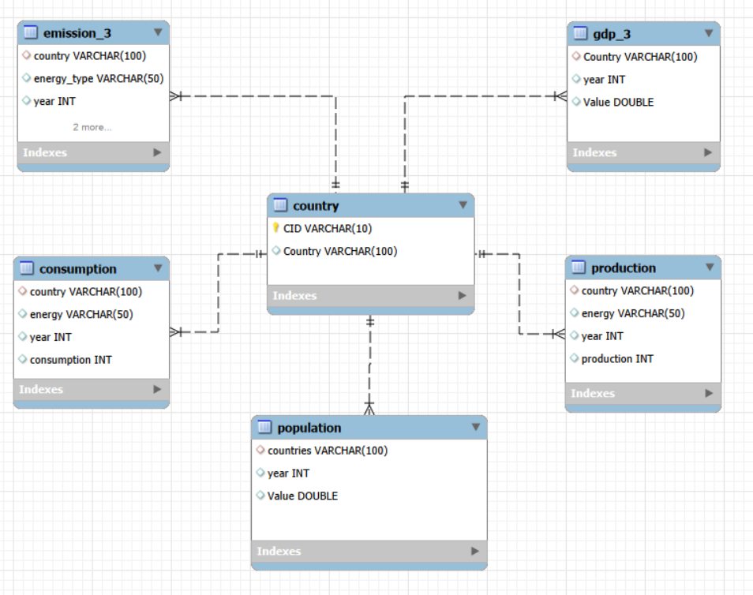
Entity Relationship Structure
The ER diagram represents the structural design of the ENERGYDB2 database and shows how all tables are logically connected.
The country table acts as the central entity and contains the primary key (CID), which uniquely identifies each country.
All other tables (emission_3, production, consumption, gdp_3, population) have a foreign key referencing the country table.
The relationships between country and other tables follow a One-to-Many (1:N) relationship model.

Slide 6
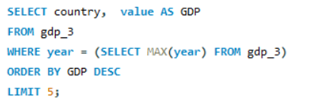
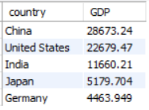
General & Comparative Analysis
1. What are the top 5 countries by GDP in the most recent year?
The query uses a subquery with MAX(year) to get the latest data, then applies ORDER BY DESC and LIMIT 5 to identify the top economies.
The output shows that major economies like the United States and China dominate global GDP rankings.
These countries typically have higher industrial activity and energy demand, which often correlates with increased energy consumption and emissions.

Slide 7
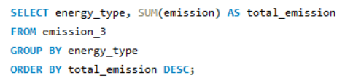
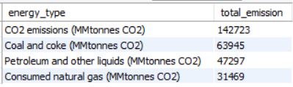
2. Which energy types contribute most to emissions across all countries?
The query uses SUM() to calculate the total, GROUP BY to categorize by energy type, and ORDER BY DESC to rank highest emissions first.
CO₂ emissions show the highest total value, indicating overall emission levels are significantly high across countries.
Coal and coke contribute more emissions than petroleum and natural gas, highlighting coal as the major fossil fuel source.

Slide 8
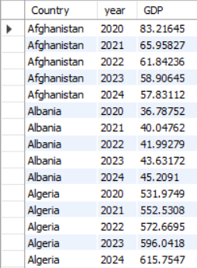

Trend Analysis Over Time
1. What is the trend in GDP for each country?
The query retrieves country-wise yearly GDP data and orders it using ORDER BY Country, year to analyze trends chronologically.
The GDP values show how each country’s economy changes over the years, helping identify growth or decline patterns.
Most countries generally show an upward GDP trend, indicating economic expansion over time.

Slide 9
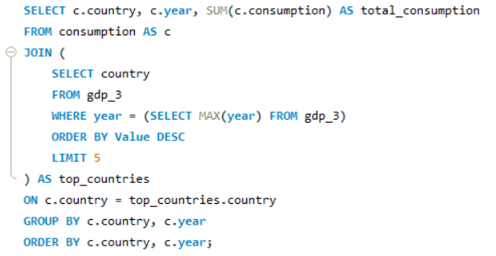
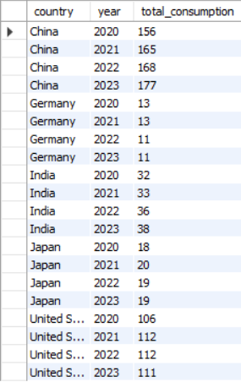
2. Has energy consumption increased or decreased over the years for major economies?
The query first selects the top 5 economies using a subquery on latest GDP, then joins with the consumption table and groups by country and year to analyze yearly trends.
Energy consumption for major economies generally shows an increasing trend over the years, reflecting growing industrial and economic activities.
The rise in consumption aligns with higher GDP countries, indicating strong demand for energy in developed nations.

Slide 10
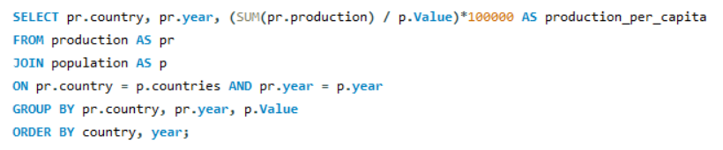
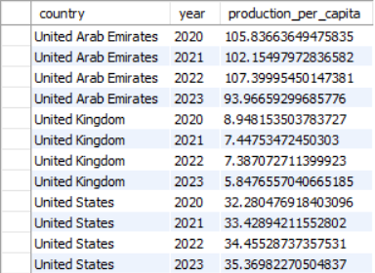
Ratio & Per Capita Analysis
1. How does energy production per capita vary across countries?
The query joins production and population tables, calculates per capita production using total production divided by population, and orders the results country-wise and year-wise for comparison.
Energy production per capita varies significantly across countries, with smaller or energy-rich nations often showing higher per-person output.
Countries with large populations tend to have lower production per capita despite high total production levels.

Slide 11
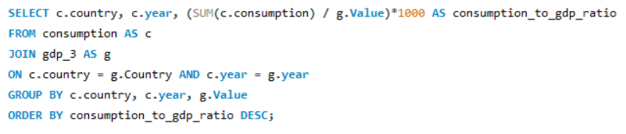
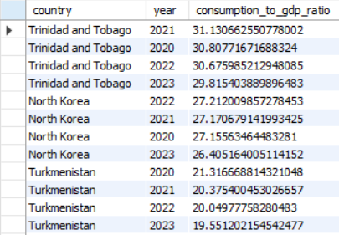
2. Which countries have the highest energy consumption relative to GDP?
The query joins consumption and GDP tables, calculates the consumption-to-GDP ratio using aggregated consumption divided by GDP, and orders the results in descending order to identify the highest values.
Countries with the highest consumption-to-GDP ratio use more energy relative to their economic output, indicating lower energy efficiency.
Economies with lower ratios are generally more efficient, producing higher GDP with comparatively less energy usage.

Slide 12
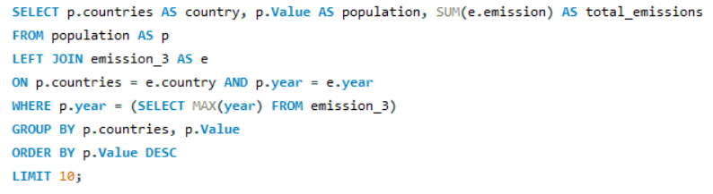
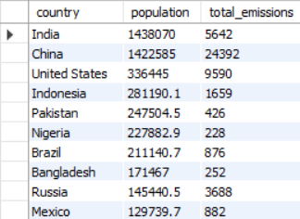
Global Comparisons
1. What are the top 10 countries by population and how do their emissions compare?
The query selects the top 10 countries by population for the latest year, joins with emission data using LEFT JOIN, aggregates emissions using SUM(), and orders by population in descending order to compare both metrics.
India and China have the highest populations, but China’s total emissions are significantly higher, showing population alone does not determine emission levels.
The United States has lower population than India and China but still shows very high emissions due to industrial and energy consumption intensity.

Slide 13
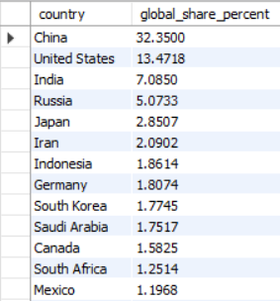
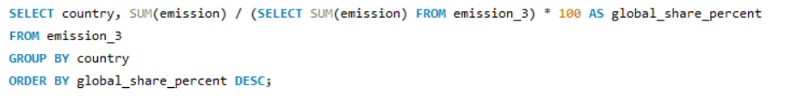
2. What is the global share (%) of emissions by country?
The query calculates each country’s emission percentage by dividing its total emissions by the global total using a subquery, then groups by country and orders the results in descending order.
China holds the largest global emission share at around 32%, followed by the United States and India, showing emissions are concentrated among major economies.
A few countries contribute a significant portion of total global emissions, while many others have relatively smaller shares.

Slide 14
Recommendations
Countries should reduce dependence on coal and fossil fuels and increase investment in renewable energy sources to lower emissions.
Major economies with high emission shares should implement stricter carbon regulations and adopt cleaner technologies.
Governments should improve energy efficiency to reduce energy consumption relative to GDP.
Population-heavy countries must focus on sustainable urban planning and energy-efficient infrastructure.
Policymakers should promote green energy incentives and carbon taxation to encourage environmental responsibility.
International collaboration is necessary to control global emissions and achieve long-term climate sustainability goals.

Slide 15
Conclusion
The analysis shows a strong relationship between economic growth, energy consumption, and carbon emissions across countries.
Major economies contribute the highest share of global emissions due to large-scale industrial and energy activities.
Fossil fuels, especially coal, remain the dominant source of global emissions.
Energy consumption has generally increased over the years, aligning with GDP growth trends.
Population size alone does not determine emissions; economic intensity and energy sources play a bigger role.
Sustainable energy transitions and improved energy efficiency are essential for balancing economic development with environmental protection.

Slide 16


Slide 17

THANK YOU

